Slide 1
Processes and Threads
Chapter 2
2.1 Processes
2.2 Threads
2.3 Scheduling
2.4 Interprocess communication

Slide 2
2.1 Processes

Slide 3
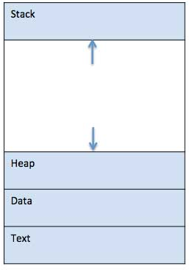
What is a process?
A process is basically a program in execution. When a program is loaded into the memory and it becomes a process, it can be divided into four sections ─ stack, heap, text and data. The following image shows a simplified layout of a process inside main memory.
Stack: The process Stack contains the temporary data such as method/function parameters, return address and local variables.
Heap: This is dynamically allocated memory to a process during its run time.
Text: This includes the current activity represented by the value of Program Counter and the contents of the processor's registers.
Data: This section contains the global and static variables.

Slide 4
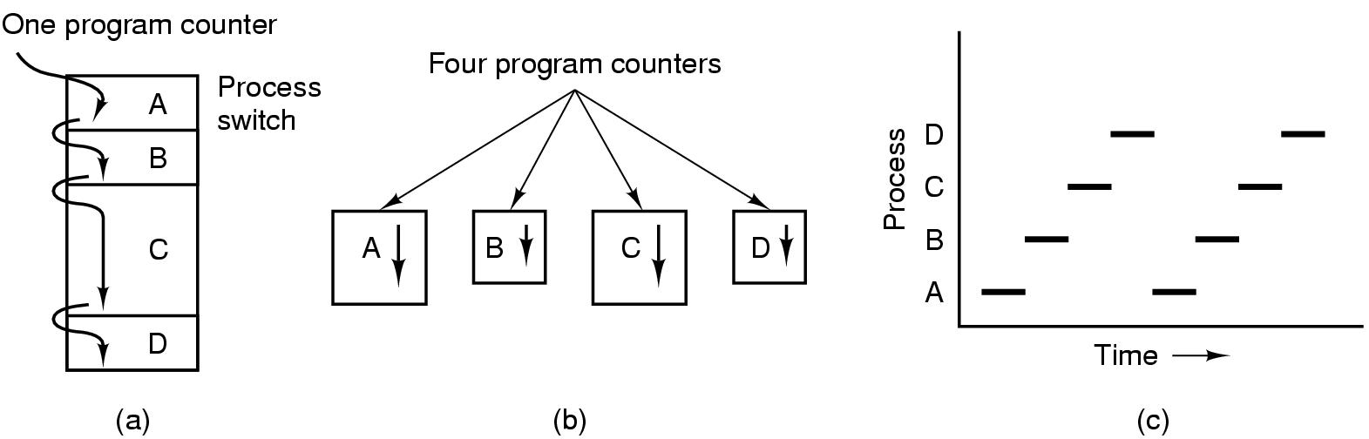
The Process Model - 1
Multiprogramming of four programs
Conceptual model of 4 independent, sequential processes
Only one program active at any instant

Slide 5
The Process Model - 2
An operating system executes a variety of programs:
Batch system – jobs
Time-shared systems – user programs or tasks
A process resources includes:
Address space (text segment, data segment)
CPU (virtual)
program counter
registers
stack
Other resource
(open files, child processes…)
In the simplest terms, a batch job is a scheduled program that is assigned to run on a computer without further user interaction. Batch jobs are often queued up during working hours, then executed during the evening or weekend when the computer is idle.

Slide 6
Process Creation (1)
Principal events that cause process creation
System initialization (When an operating system is booted, typically numerous processes are created. Some of these are foreground processes).
2. Execution of a process-creation system call by running process (Often a running process will issue system calls to create one or more new processes to help it do its job).
3. User request to create a new process
4. Initiation of a batch job (users can submit batch jobs to the system).

Slide 7
Process Creation (2)
Address space
Child duplicate of parent (When a process creates new process, a duplicate of that process is created. This new process is called the child and the process that created it is called the parent. The child process then replaces the copy for the code the parent process created with the code the child process is supposed to execute)
Child has a program loaded into it
UNIX examples
fork system call creates new process
exec system call used after a fork to replace the process’ memory space with a new program

Slide 8
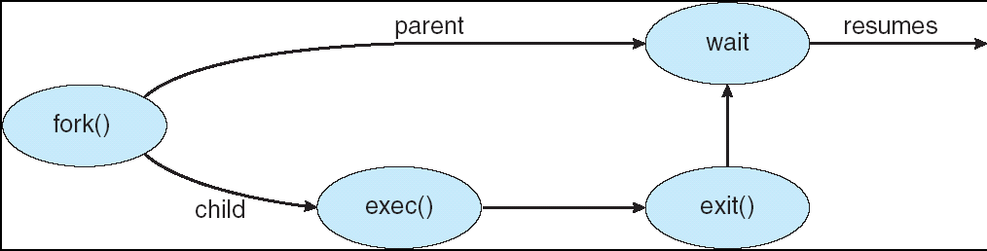
Process Creation (3) : Example

Slide 9
Process Termination
Conditions which terminate processes
Normal exit (voluntary)
Fatal error (voluntary)
Error exit (involuntary)
Killed by another process (involuntary)

Slide 10
Process Hierarchies
Parent creates a child process, child processes can create its own process
Forms a hierarchy
UNIX calls this a "process group"
Windows has no concept of process hierarchy
all processes are created equal

Slide 11
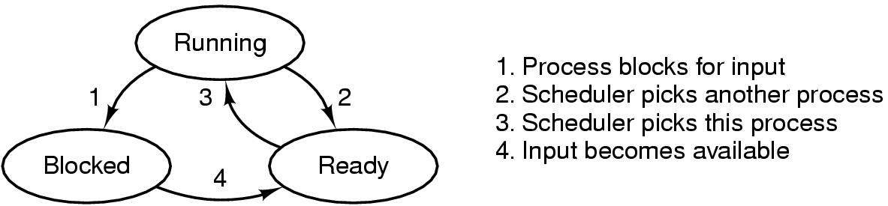
Process States (1)
Possible process states
running
blocked
ready
Transitions between states shown

Slide 12
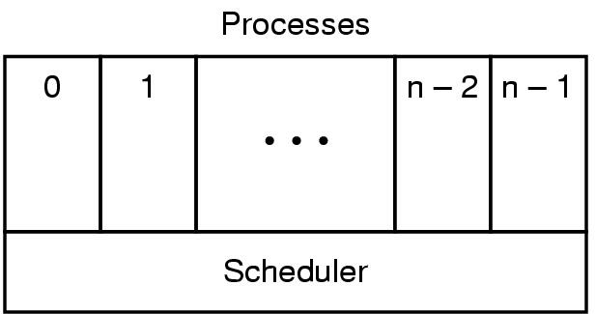
Process States (2)
Lowest layer of process-structured OS
handles interrupts, scheduling
Above that layer are sequential processes

Slide 13
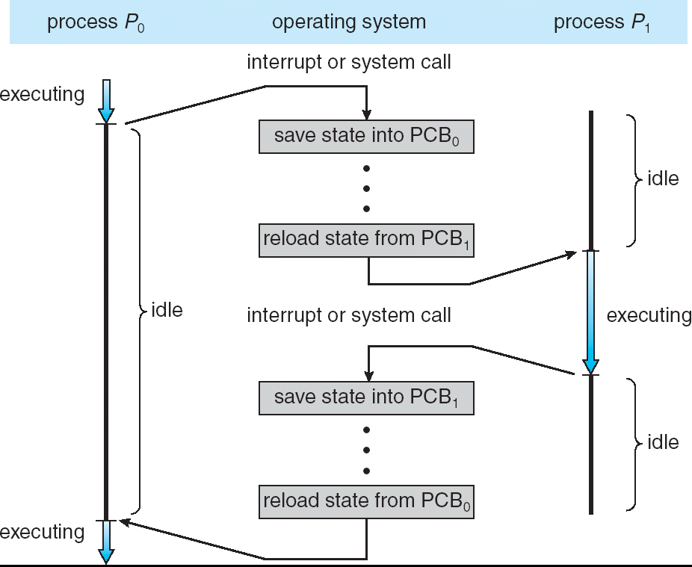
Processes context switch

Slide 14
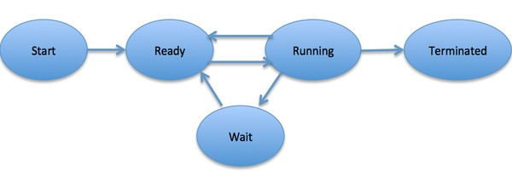
Implementation of Processes (1)
To implement the process model, the operating system maintains a table (an array of structures), called the process table , with one entry per process. (Some authors call these entries process control blocks .) This entry contains important information about the process’ state, including its program counter, stack pointer, memory allocation, ...
Process Life Cycle
When a process executes, it passes through different states. These stages may differ in different operating systems, and the names of these states are also not standardized.
In general, a process can have one of the following five states at a time.

Slide 15
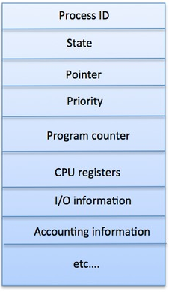
Process Control Block (PCB) - 1
Implementation of Processes (2)
A Process Control Block is a data structure maintained by the Operating System for every process. A PCB keeps all the information needed to keep track of a process. The architecture of a PCB is completely dependent on Operating System. Here is a simplified diagram of a PCB.
PCB is mostly stored as per-process kernel stack which is in the kernel space and kernel has access to this which is kept protected from any users.

Slide 16
Process Control Block (PCB) - 2
1 | Process State: The current state of the process i.e., whether it is ready, running, waiting, or whatever.
2 | Process privileges: This is required to allow/disallow access to system resources.
3 | Process ID: Unique identification for each of the process in the operating system.
4 | Pointer: A pointer to parent process.
5 | Program Counter: Program Counter is a pointer to the address of the next instruction to be executed for this process.
6 | CPU registers: Various CPU registers where process need to be stored for execution for running state.
7 | CPU Scheduling Information: Process priority and other scheduling information which is required to schedule the process.
8 | Memory management information: This includes the information of page table, memory limits, Segment table depending on memory used by the operating system.
9 | Accounting information: This includes the amount of CPU used for process execution, time limits, execution ID etc.
10 | IO status information: This includes a list of I/O devices allocated to the process.

Slide 17
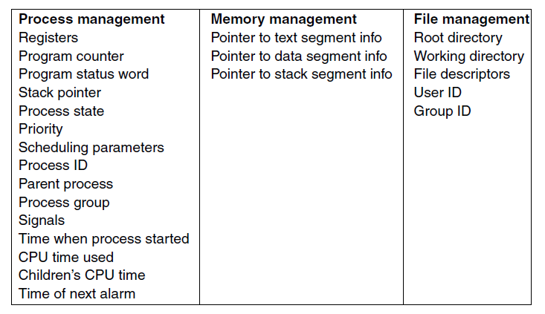
Implementation of Processes (2)
The above figure shows some of the key fields in a typical system. The fields in the first column relate to process management. The other two relate to memory management and file management, respectively. It

Slide 18
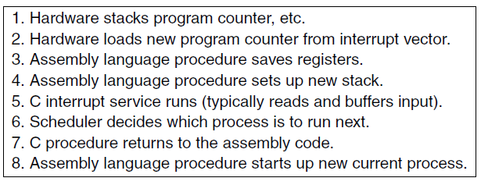
Modeling Multiprogramming (1)
When multiprogramming is used, the CPU utilization can be improved. Crudely put, if the average process computes only 20% of the time it is sitting in memory, then with five processes in memory at once the CPU should be busy all the time. This model is unrealistically optimistic, however, since it tacitly assumes that all five processes will never be waiting for I/O at the same time.
Skeleton of what the lowest level of the operating system does when an interrupt occurs.

Slide 19
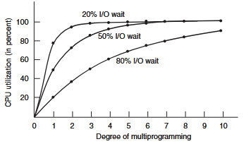
Modeling Multiprogramming (2)
A better model is to look at CPU usage from a probabilistic viewpoint. Suppose that a process spends a fraction p of its time waiting for I/O to complete. With n processes in memory at once, the probability that all n processes are waiting for I/O (in which case the CPU will be idle) is p^{n}. The CPU utilization is then given by the formula CPU utilization = 1 − p^{n}
The figure on the right shows the CPU utilization as a function of n, which is called the degree of multiprogramming.
Skeleton of what the lowest level of the operating system does when an interrupt occurs.

